Slide 1
Carbon Canyon Community Wildfire Protection Plan (CWPP)
5 to 10 year Fire Safe Plan for Carbon Canyon
Update of an existing plan developed in 2002 which only included Chino Hills
Prioritize Fuel Reduction Projects
Create Fire Safe Neighborhoods
Collaboration between Government Agencies and the Community

Slide 2
CWPP Partners and Stakeholders
Partners:
Chino Valley Fire
Brea Fire
State Parks
Cal Fire
More than 50 Stakeholders, such as:
Cities of Brea and Chino Hills
Counties of San Bernardino, Orange, and Los Angeles
Utilities, HOA’s, Churches, and other large property owners
US Fish and Wildlife and State Dept of Fish and Game

Slide 3
Community Meetings

Slide 4
Community Meetings

Slide 5
Project Area Map

Slide 6
Fire History Map
Over the last 50 years there have been 18 fires that have burned 89,209 acres

Slide 7
Fire Origins Map
Over the last 50 years there have been 18 fires that have burned 89,209 acres

Slide 8
Risk Assessment
CARBON CANYON COMMUNITY WILDFIRE PROTECTION PLAN
COMMUNITY RISK ASSESSMENT
 | LEVEL OF IMPACT: | 8 | 8 | 8 | 10
VERSION 3 |  | FIRE RISK
 |  |  |  |  | BLDG CONSTR/ |  | FIRE
 |  | FIRE | FUEL | SLOPES | DENSITY |  | RISK
 |  | FREQUENCY | RISK | RISK | RISK |  | TOTALS
STRUCTURES
SINGLE/MULTIFAMILY HOUSING
 | OLINDA RANCH | 5 | 5 | 3 | 5 |  | 154
 | OLINDA VILLAGE | 8 | 6 | 6 | 6 |  | 220
 | SLEEPY HOLLOW | 7 | 8 | 7 | 8 |  | 256
 | MOUNTAIN VIEW ESTATES | 7 | 8 | 10 | 10 |  | 300
 | OAK TREE DOWNS | 8 | 5 | 5 | 2 |  | 164
 | PINE VALLEY ESTATES | 8 | 5 | 6 | 2 |  | 172
 | WESTERN HILLS OAKS | 8 | 6 | 7 | 5 |  | 218
 | CARRIAGE HILLS | 5 | 5 | 6 | 5 |  | 178
 | SUMMIT RANCH | 5 | 5 | 4 | 5 |  | 162

Slide 9
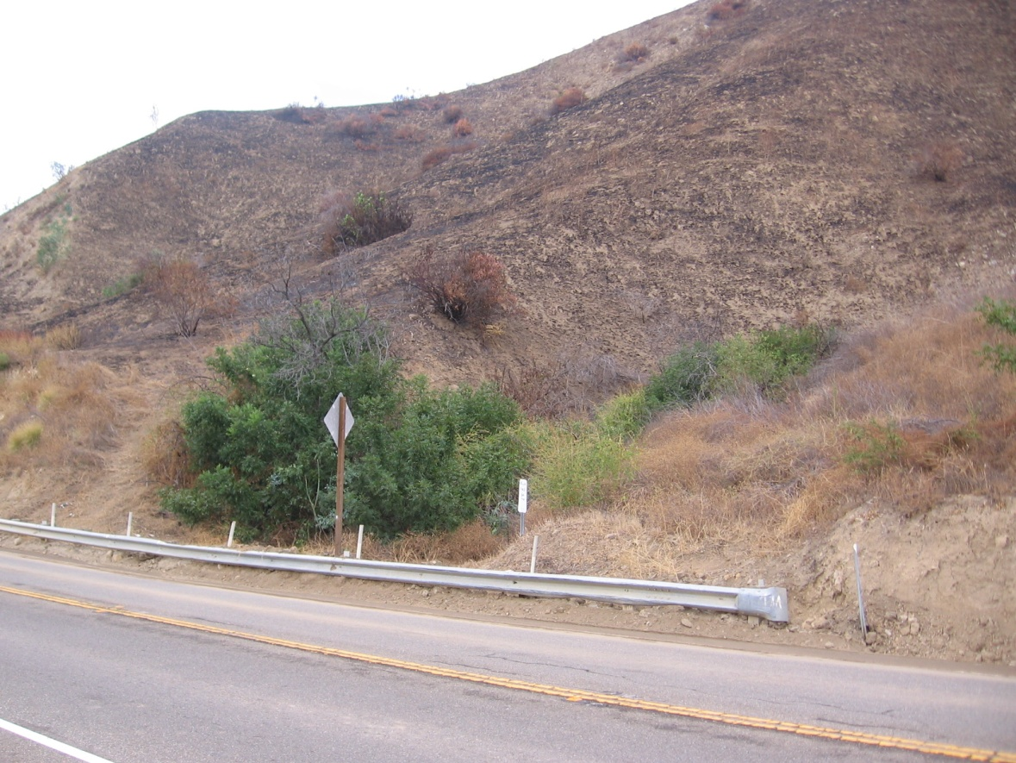
Priorities & Recommendations
Carbon Canyon Road
Mobile Home Parks
Fire Plans for all Institutional and Industrial Entities in the Canyon

Slide 10
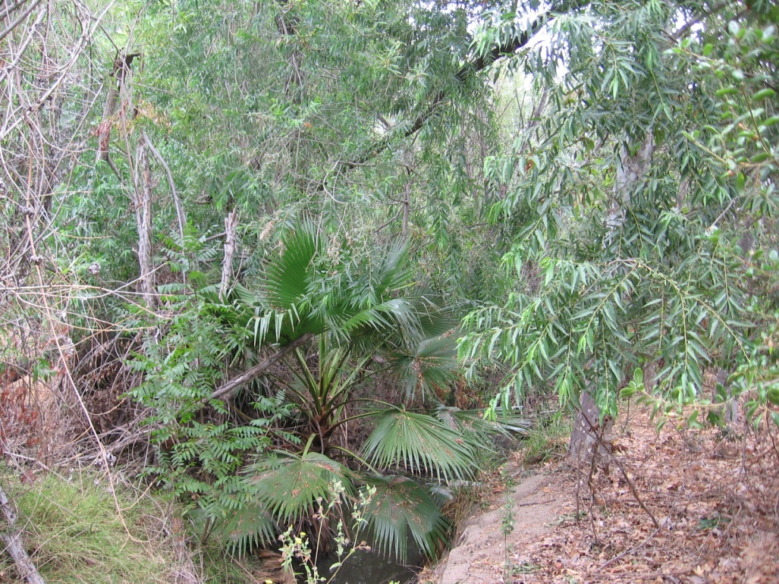
Priorities & Recommendations
Vegetation Management
Creating Fire Safe Neighborhoods

Slide 11
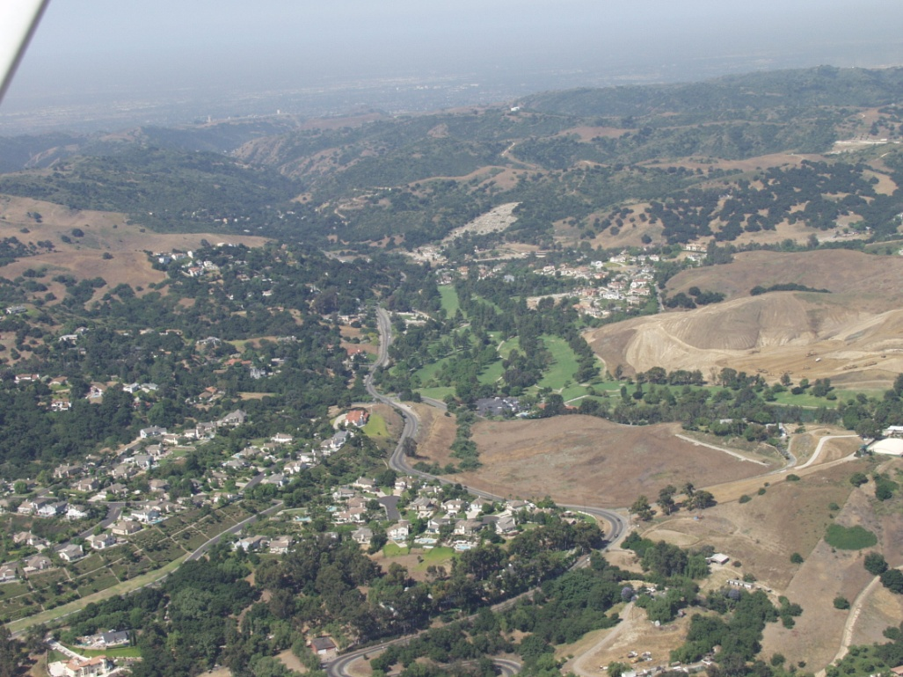
Priorities & Recommendations
Accurate Weather Information
Pre-Attack Action Plans
Fire Watch Programs
Disaster Communication Programs

Slide 12
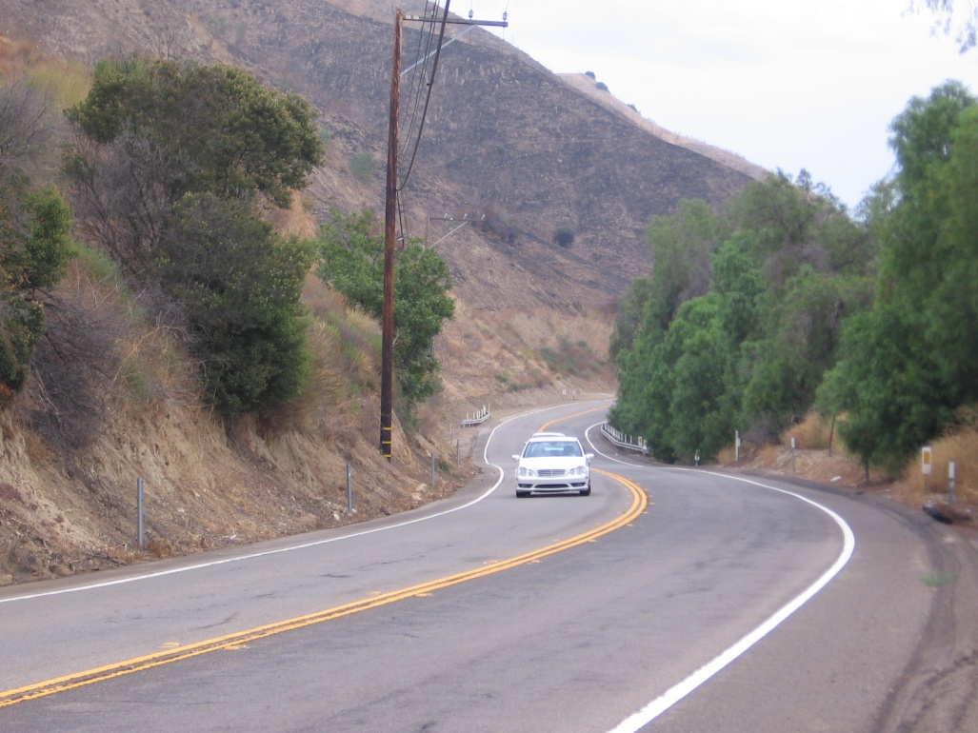
Priorities & Recommendations
Electric Power Poles
Gold Spotted Oak Borer
Firestone Boy Scout Reservation

Slide 13
Action Plan
Develop an Action Plan to implement the above Priorities and Recommendations
Detailed list for 28 projects:
Who will provide and do what
Funding
Timeline
Monitoring and Evaluation

Slide 14
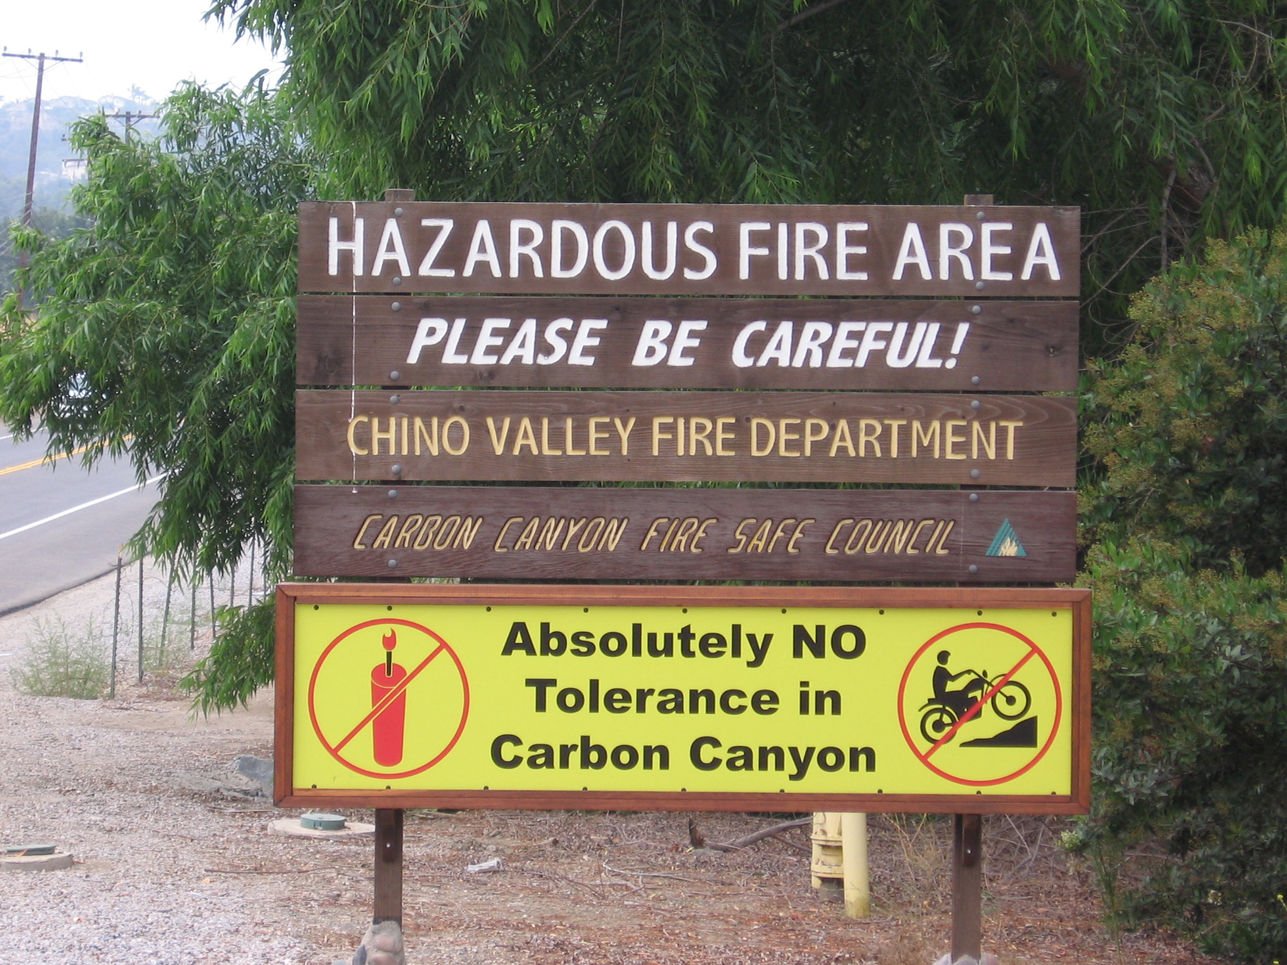
Approval of CWPP
Obtain official’s signatures and approval by Cal Fire
http://sites.google.com/site/carboncanyoncwpp/home/c-w-p-p-draft-maps

